Slide 1
MCA Final Year Project (Review III) Rebil
Submitted to the Presidency University, Bengaluru in partial fulfilment for the award of the degree of Master of Computer Applications(MCA)
Project Number : MCA_PR216
Under the supervision of
Mr. Sakthi S Asst.Prof-SCSE Presidency University
Name | Roll Number
DEEPAK KUMAR SINGH D | 20232MCA0198

Slide 2
Content
Abstract
Problem Statement
Screenshots
Github Link

Slide 3
Abstract
Web-Based HR Platform: Built with HTML, CSS, Bootstrap and PHP to streamline HR and admin tasks.
Recruitment Management: Includes an Applicant Tracking System (ATS) for handling applications, interviews and offers.
Document Handling: Allows secure upload, organized storage and quick search of HR documents.
Compliance Tracking: Ensures hiring processes follow company policies and industry standards.
Future Plans: Will add AI-based analytics for better candidate insights and cloud storage for improved security and scalability.

Slide 4
Problem Statement
Many HR departments struggle with managing recruitment, documents and compliance due to the lack of a unified system.
Tracking candidates manually through the hiring process leads to inefficiencies and disorganization.
Storing and retrieving HR documents can be slow and insecure without a proper digital solution.
Ensuring that hiring practices follow company policies and legal standards is challenging without compliance tracking tools.
Current systems often lack scalability, security and advanced features like AI-driven analytics for better decision making.

Slide 5
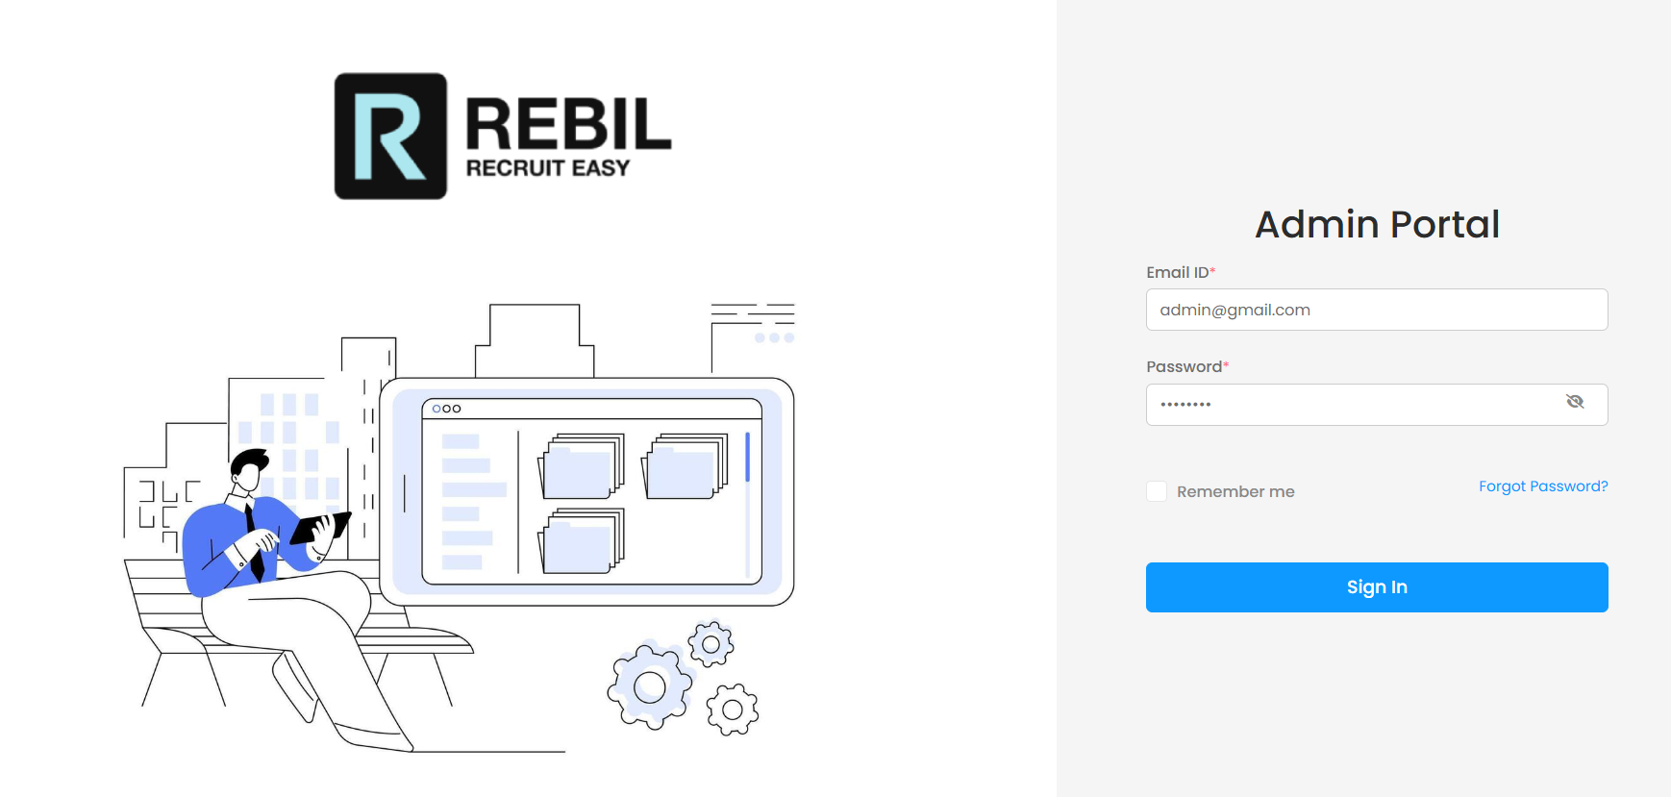
Screenshots
Admin Login Portal

Slide 6
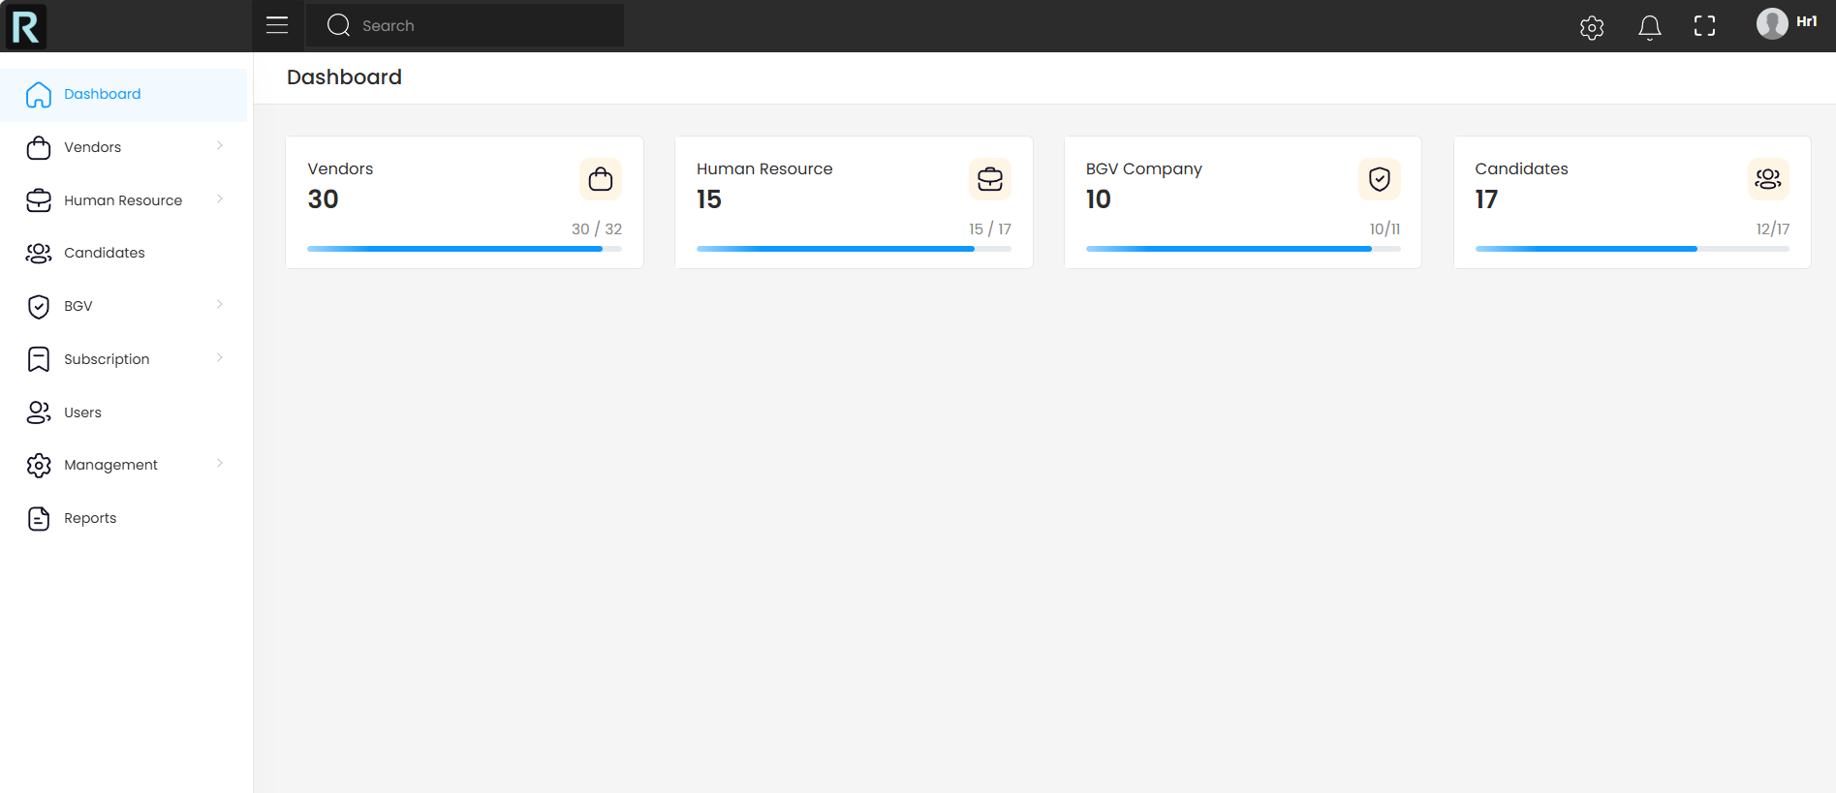
Admin Dashboard

Slide 7
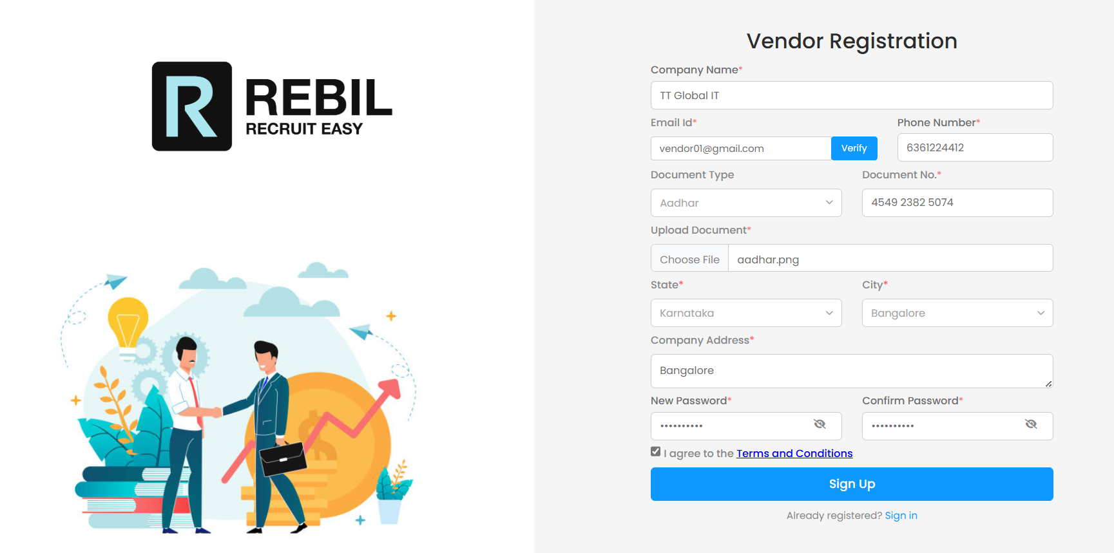
Vendor Registration Portal

Slide 8
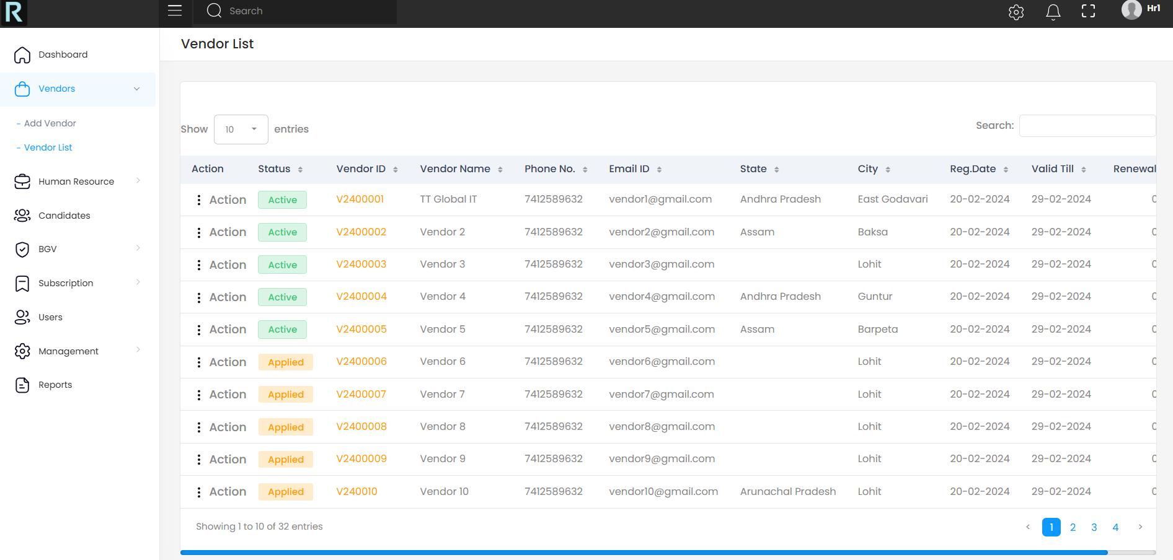
Vendor List

Slide 9
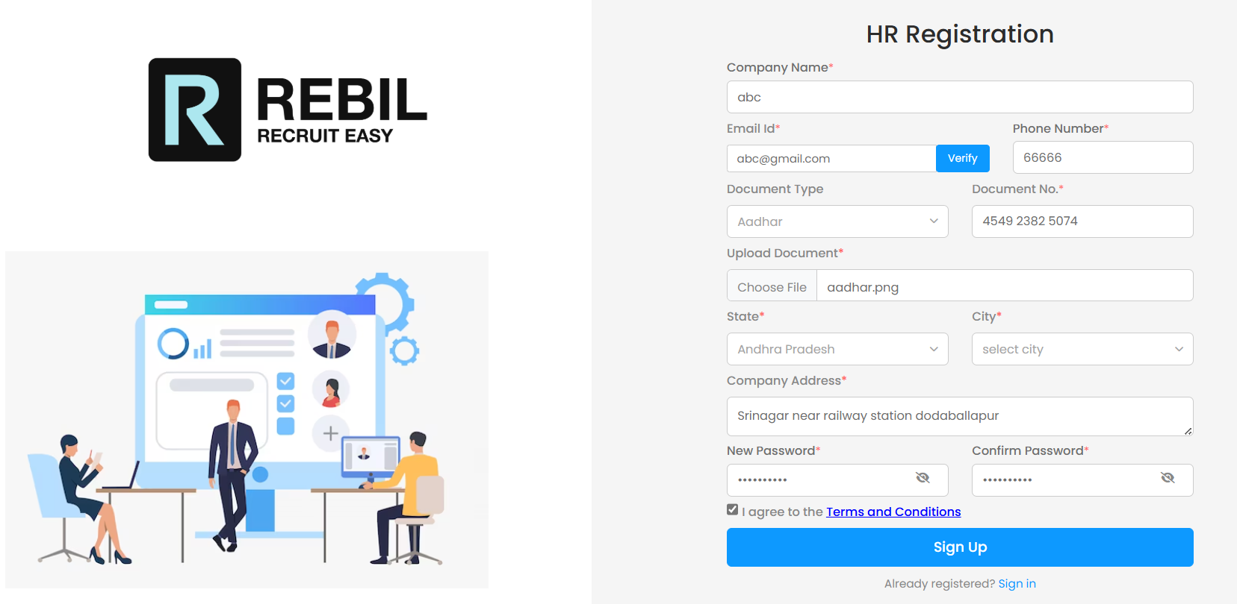
HR Registration Portal

Slide 10
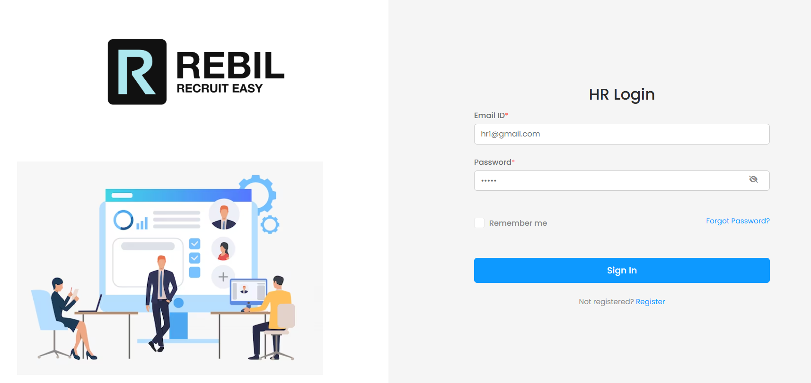
HR Login Portal

Slide 11
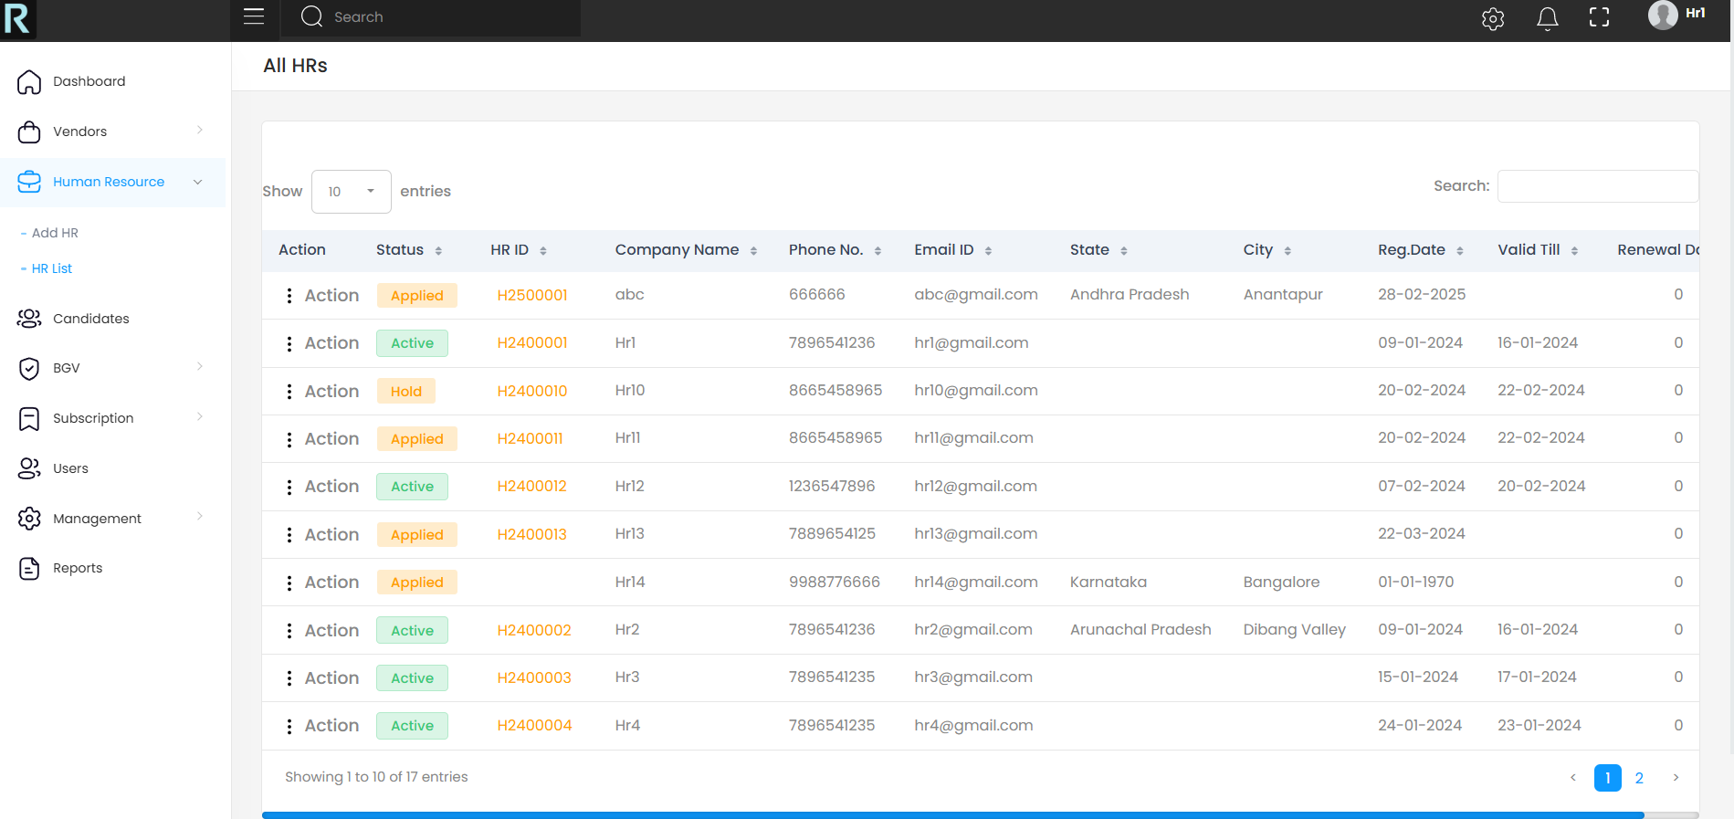
HR List

Slide 12
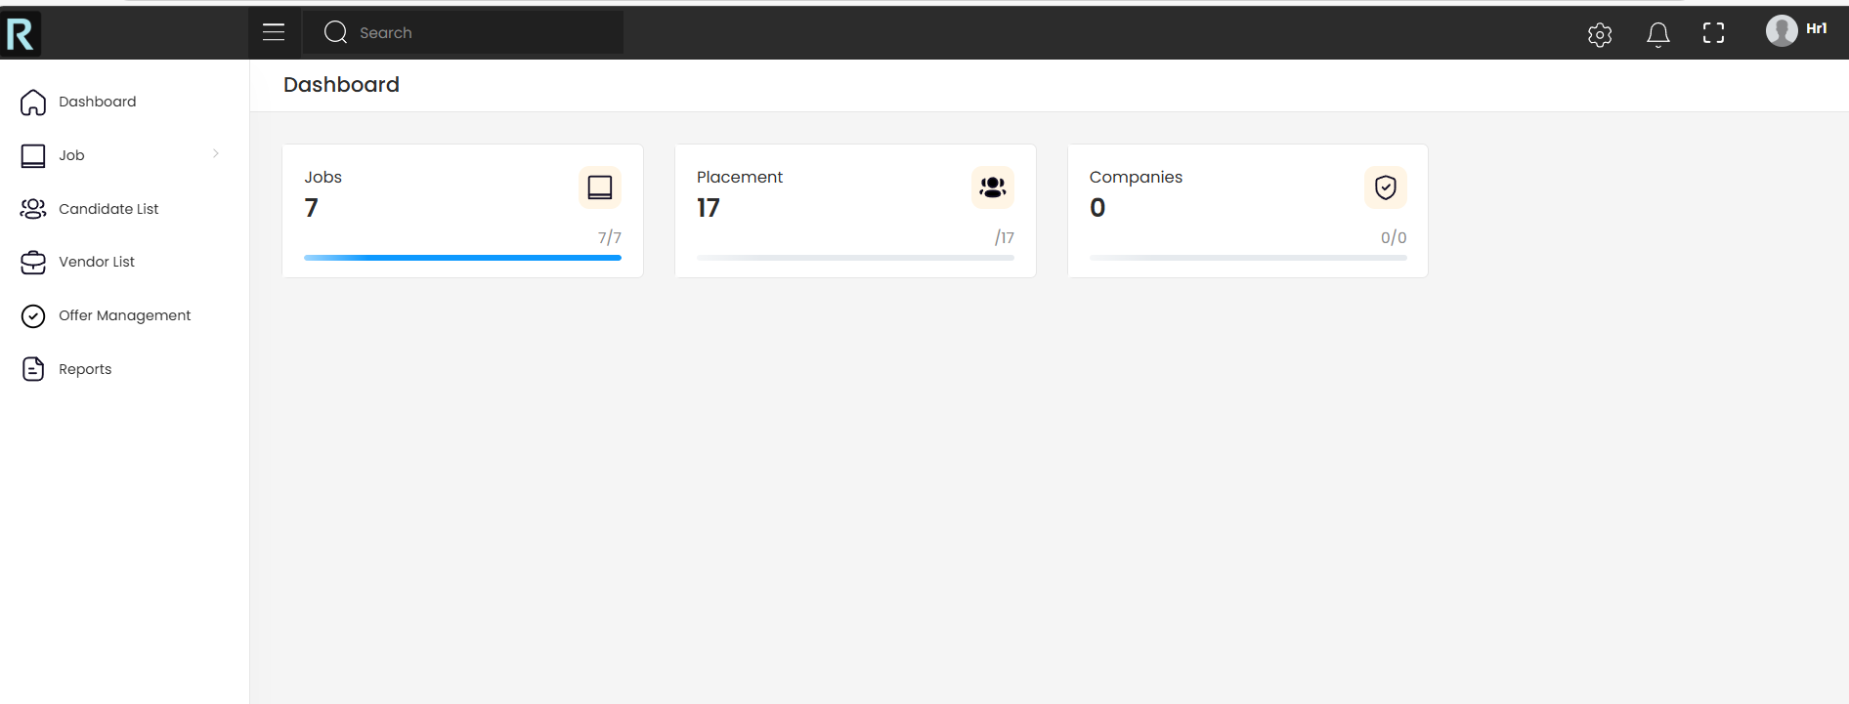
HR Dashboard

Slide 13
Github Link
GitHub Repository:
https://github.com/Deepak-kumar-Singh-D/Rebil

Slide 14


